Slide 1
Golden Connection Logistics
Desiree Noelani Staton
Fall 2016

Slide 2
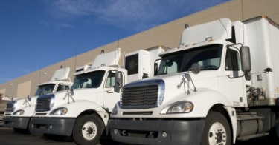
Golden Connection Logistics Trucking Company

Slide 3
Golden Connection Logistics Trucking Company
Golden Connection Logistics is a company that has always strived to be great. Working side by side with fortune 500 companies and some of the best logistics companies in North America we have certified our place in the industry. Providing solutions for every aspect of your supply chain needs such as LTL, FTL, Expedited Cargo, and Warehousing.

Slide 4
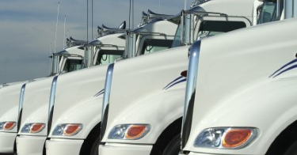
Golden Connection Logistics Trucking Company

Slide 5
Golden Connection Logistics Trucking Company
Golden Connection Logistics is a family owned and operated company
GCL is modeled on providing transportation services to clients in the increasing demand market.
GCL is conveniently located 5 minutes away from the Los Angeles International Airport, 20 minutes from Downtown Los Angeles and 25 minutes to the Long Beach Port.

Slide 6
Golden Connection Logistics Trucking Company
GCL has set the standard for customer service. With our top of the line tracking system and our ability to communicate clearly and in real time, you will always be able to track your shipment every step of the way. We take pride in logistics and understand the importance of each and every shipment. With our 24-hour team, you can rest assure, you will always have someone ready to assist around the clock.
GCL plans to change the industry for the better by incorporating the industries latest technologies and by applying well defined values into each and every project. With the best trained team around, we continue to grow in the industry with a reputation that makes us proud. Come and partner with a team that is creating relationships that prosper and last for generations

Slide 7
Golden Connection Logistics Services
Air Freight
Ocean Freight
Trucking
Warehousing
Cargo Screening
Custom Clearance

Slide 8
Golden Connection Logistics Services
24 hour pick up and delivery
Appointment delivery
door to door
Hot shots
Convention center
Hospitals
Haz mat certified warehouse
Residential
Air Ride
Truck load
CFS/LTL

Slide 9
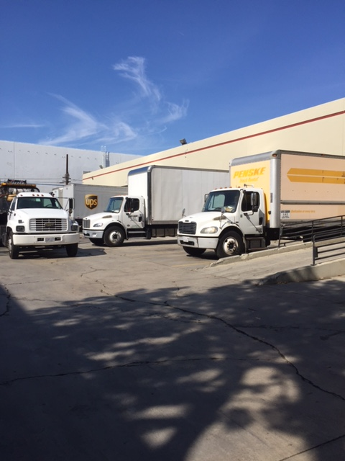
Golden Connection Logistics

Slide 10
Golden Connection Logistics Technology
Golden Connection Logistics is now partnering with Crown Data. The leader in Logistics Technology. With our new partnership and state of the art products we have been able increase productivity and customer satisfaction. Our integrated system is cutting edge and designed with your needs in mind. You are now able to submit, track, and finalize charges in the Crown Data system. For log in info please contact Michael@expert-trucking.com.

Slide 11
Golden Connection Logistics Air
As a major force in the California LTL market, and leader in Air Expedited service, our team can always go above and beyond your expectations. With years of experience, GCL always has the tools and know how to get the job done right. Regardless of the size of your company, with our industry leading customer service and fully flexible scheduling, I know we can meet all the needs of your business. Our security and dedication to all TSA matters, comes second to none. Rest assure there is no partner that is more dedicated, reliable, and in full compliance like GCL Trucking. We strive to be the best everyday.

Slide 12
Golden Connection Logistics Air

Slide 13
Golden Connection Logistics Ocean
Look to us as your single source for reliable and cost effective trucking on all ocean goods. We implement a stringent process of selecting only the best drivers in the field, and take pride in moving your ocean cargo faster and safer than any other company. Our team is extremely knowledgeable in all ocean import/export matters. We have managed to create an amazing system that incorporates technology, reliability, and experience while remaining cost effective.

Slide 14
Golden Connection Logistics Expedite Service
GCL Trucking understands the process and operations of the business world. We know how important it is to have a fast and consistent flow of goods, which is why we have trained our top of the line drivers to handle all expedited shipments in the safest and quickest manner possible. Let us show you the Golden Connection way.

Slide 15
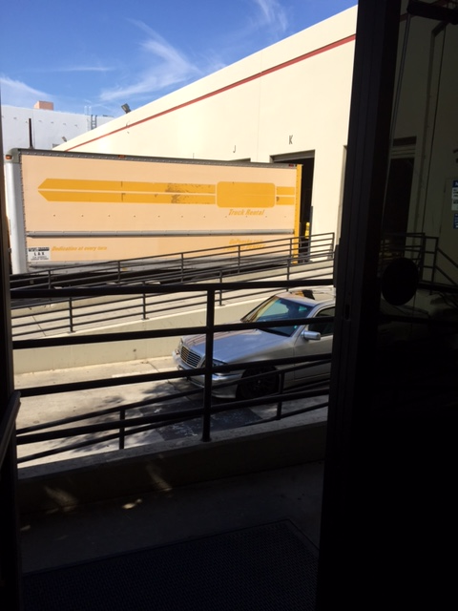
Golden Connection Logistics

Slide 16
Golden Connection Logistics Special Project
Brochure that helps promote and expand Golden Connection Logistics
Images of the company allowing clients to fully understand what GCL does
Basic information about the company
Special promo code to first time users

Slide 17
Sociological Concept
Social interaction is how we interact with people that shape our perception of their position relative to our own.
Open communication and active listening is very present at Golden Connection company. Mr. De Leon has an open door policy and wants his employees to express themselves.
Social interaction helps the company and allows people to voice their feelings.

Slide 18
Career Goals Public Health
My desire is to interact with the public as a public health leader. I would like to integrate my professional skills and experience in customer service, administrative support and management as well as my educational background in Applied Sociology, focus in Quantitative, Qualitative Research, and Data Analysis to the public.

